Slide 1
91 OG Auto Scheduler
Quick Start Guide

Slide 2
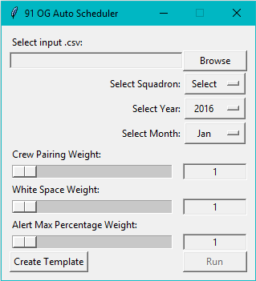
Program Interface
Weighted Variable Sliders
Crew Pairing Weight: Increasing will favor crew
pairings.
White Space Weight: Increasing will favor MCCMs
with less white space in the remainder of the
month.
i.e.: A MCCM with a large block of leave at the end
of the month will be chosen for an alert over an
MCCM with no leave.
Alert Max Percentage Weight: Increasing will favor
MCCMs who have a lower percentage of their max
alert count dedicated to alert.
i.e.: an MCCM with 1/8 alerts assigned will be
chosen over an MCCM with 4/8 alerts assigned.
Browse for input spreadsheet (.csv)
Squadron Select Dropdown
Year Select Dropdown
Month Select Dropdown
Weighted Variable Values
Runs Program. Will not be clickable until an input
.csv and squadron have been selected.
Creates a template input spreadsheet (.csv)
to be filled out.

Slide 3
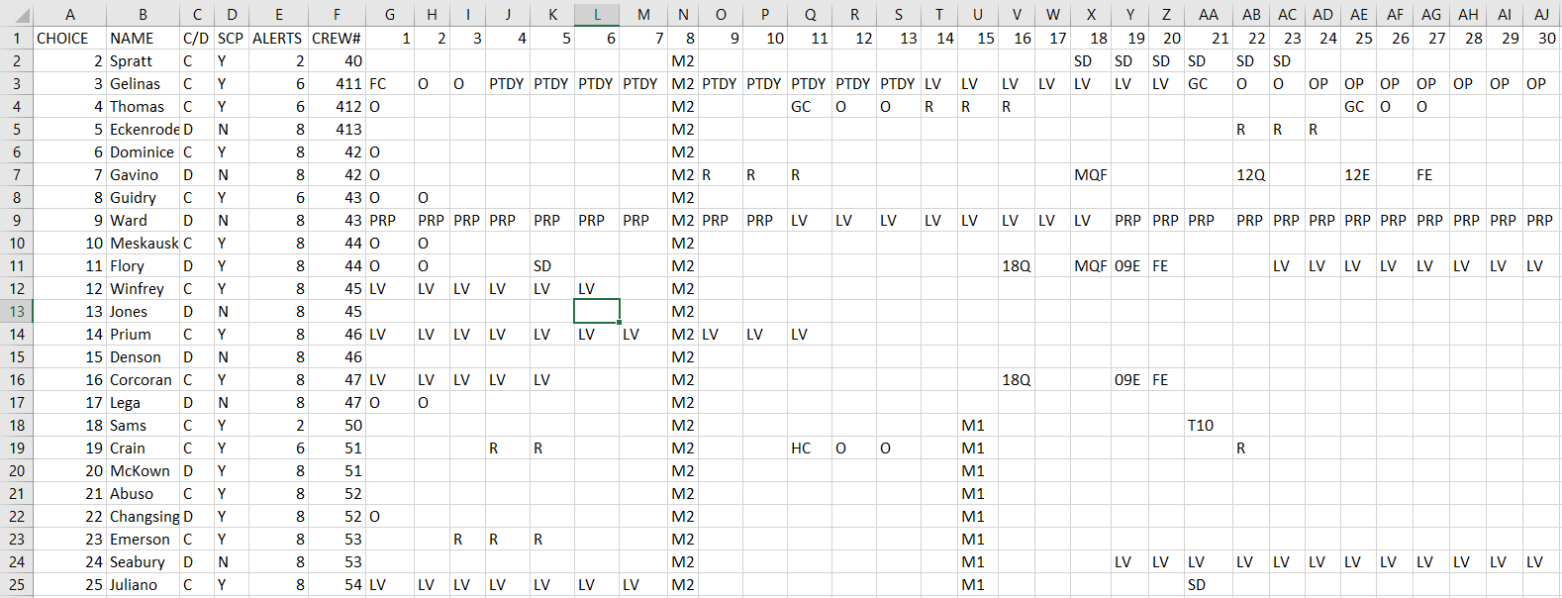
Input Spreadsheet
CHOICE: Currently unused, can be any value or blank.
ALERTS: Max alert count.
NAME: Last name (and first initial if necessary).
CREW#: Used for crew pairings. Limit two MCCMs per crew number.
C/D: Commander (C) or Deputy (D).
Month Layout: Add crew inputs. Added alerts will be considered part of the MCCMs alert
count when building the schedule, but must be entered in the following format:
[LCC][POSITION], or for example: FC for Foxtrot LCC Commander.
SCP: SCP Certified, Yes (Y) or No (N).

